Slide 1



Web Development
Name: Krish Jayesh Ramena
Rollno.:71
PRN:12415366
Branch:CSSE
Div: C
Batch:3

Slide 2
Group members
Rutika thaware (68)
Narayani yewle (69)
Rudra bokil (70)
Krish ramena (71)
Guided by : pawan wawage sir

Slide 3
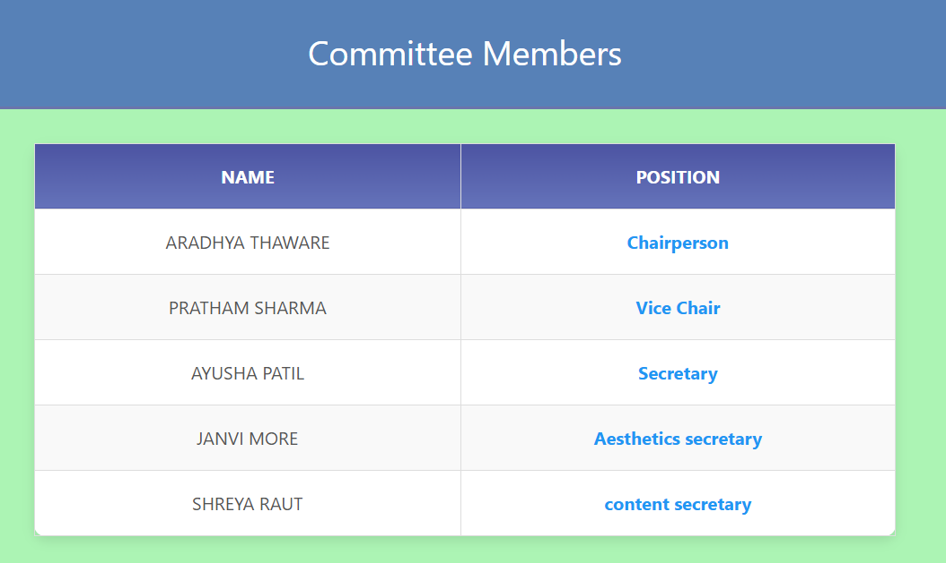
JAVASCRIPT
JavaScript is a programming language used primarily to create interactive
EFFECTS AND dynamic functionality on websites .
The first output in which javascript is used :
The selector used is document.getElementById .
FUNCTION USED ARE displayCommitteeMembers() , createElement()
appendChild(row) .

Slide 4
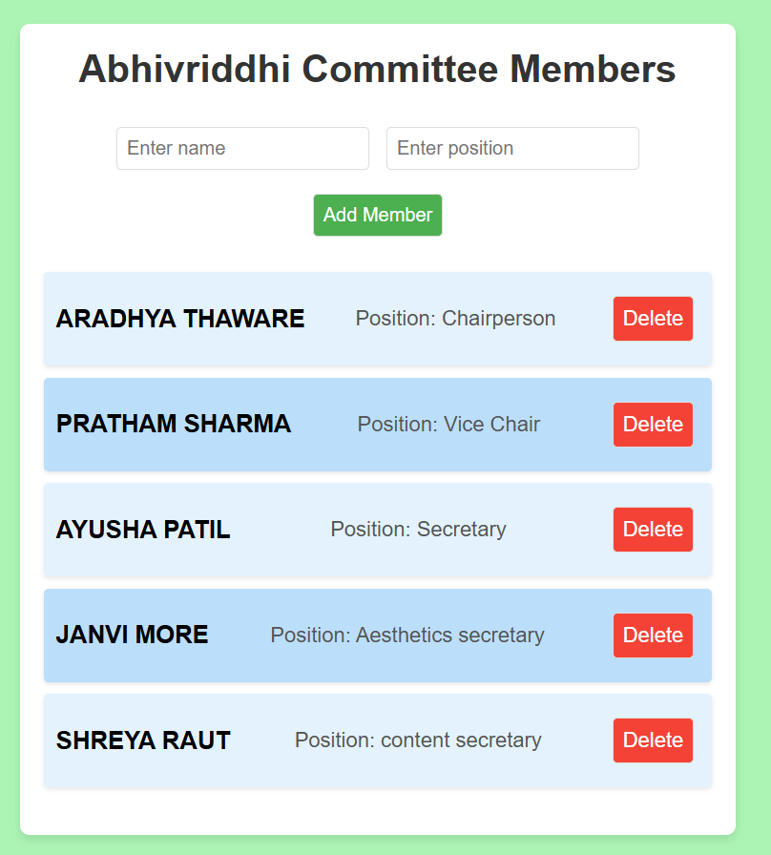
JAVASCRIPT
THE SECOND OUTPUT BY USING JAVASCRIPT :
THE SELECTORS USED ARE:
document.getElementById('member-list’)
document.getElementById('nameInput’)
document.getElementById('positionInput’)
deleteButton.onclick = () => deleteMember(index)
FUNCTION USED ARE :
displaymembers() , addmembers() ,
windows.onload displaymembers

Slide 5
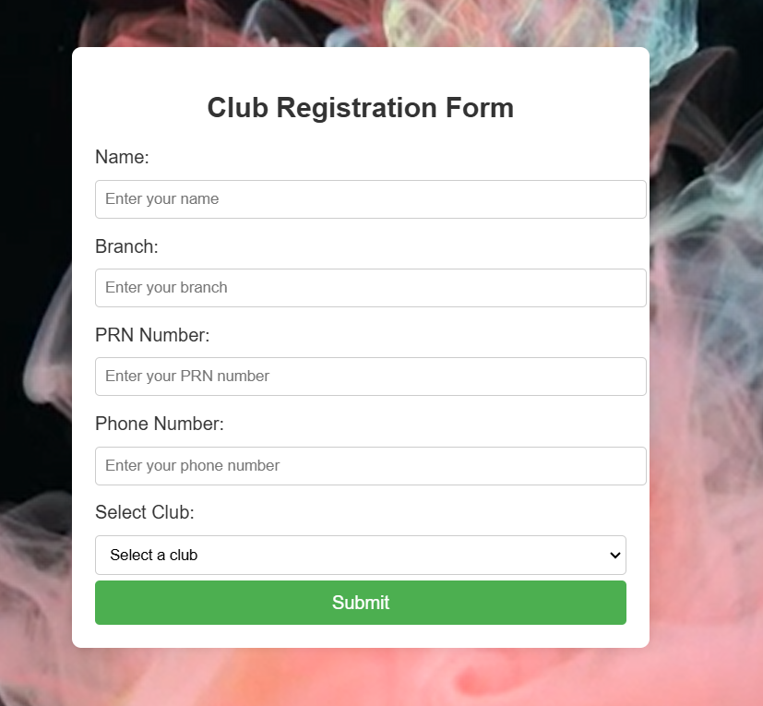
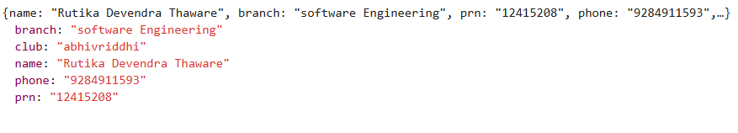
FORM VALIDATION USING JAVASCRIPT
VALIDATEFORM(): This JavaScript function is called when the form is submitted.
IT VALIDATES EACH FIELD AND CHECK IT IS EMPTY OR NOT .
IF VALID AN ALERT POPS UP THAT REGISTRATION DONE SUCCESSFULLY .
THE DATA IS STORED IN LOCAL STORAGE .

Slide 6
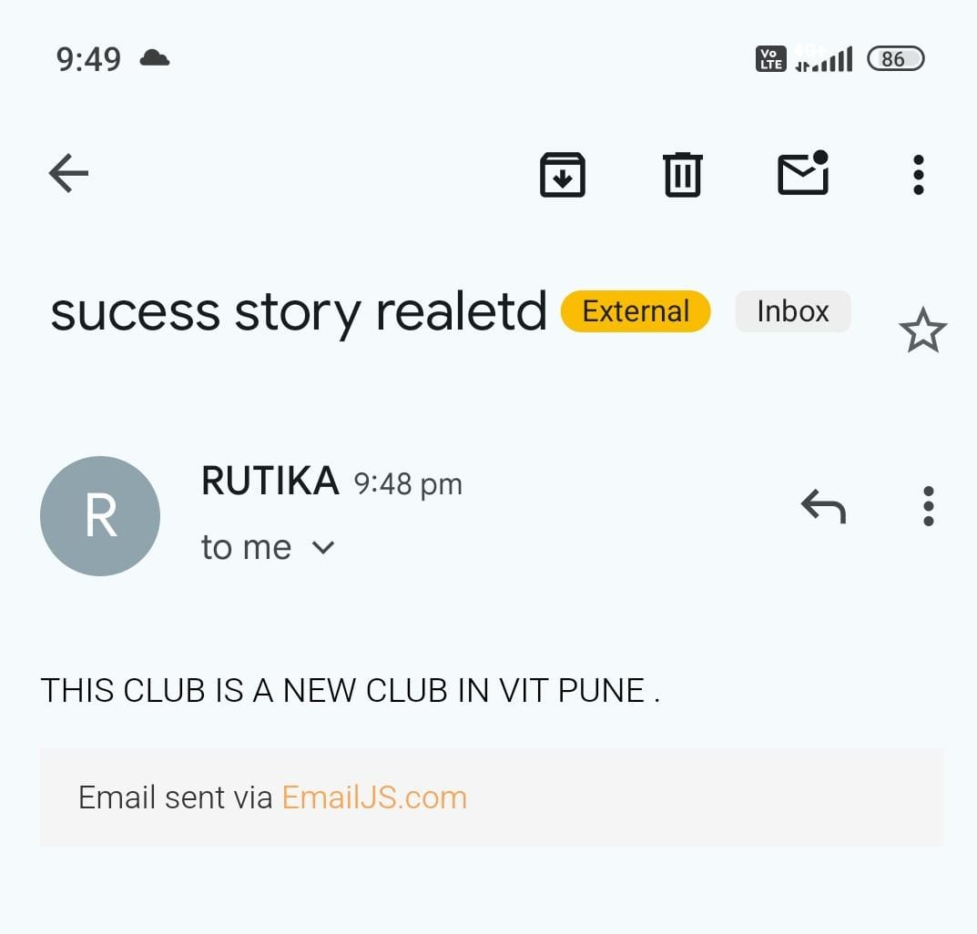
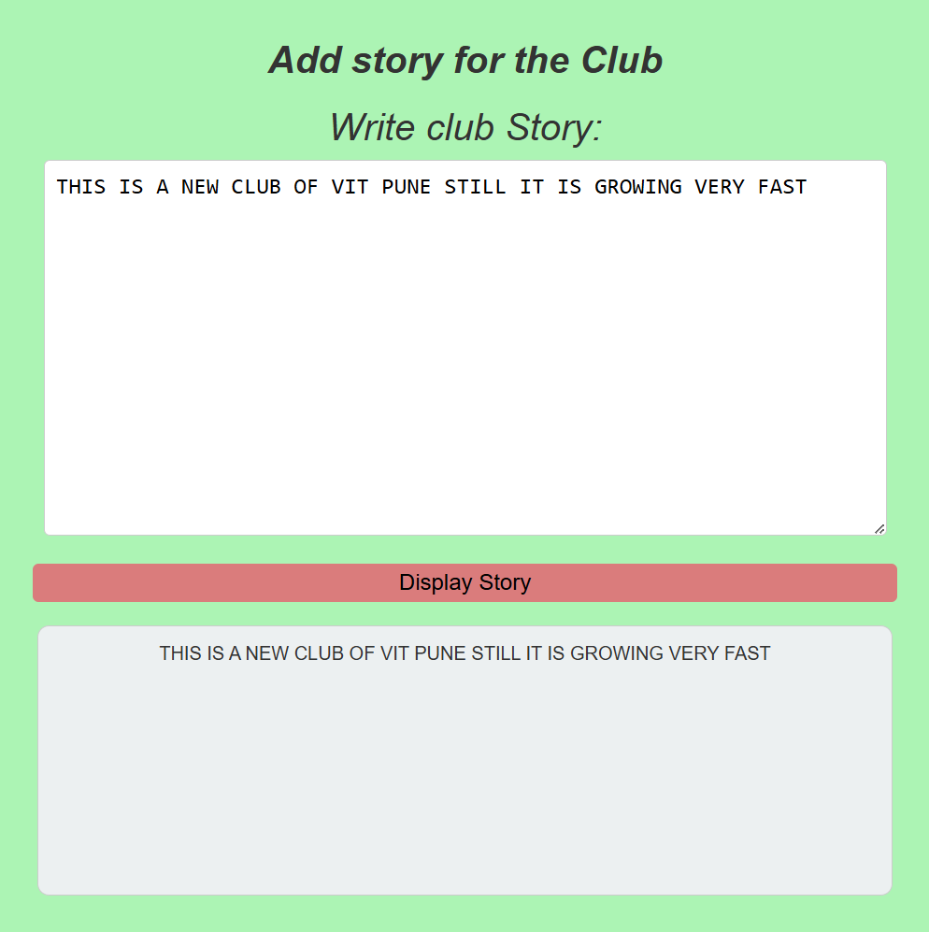
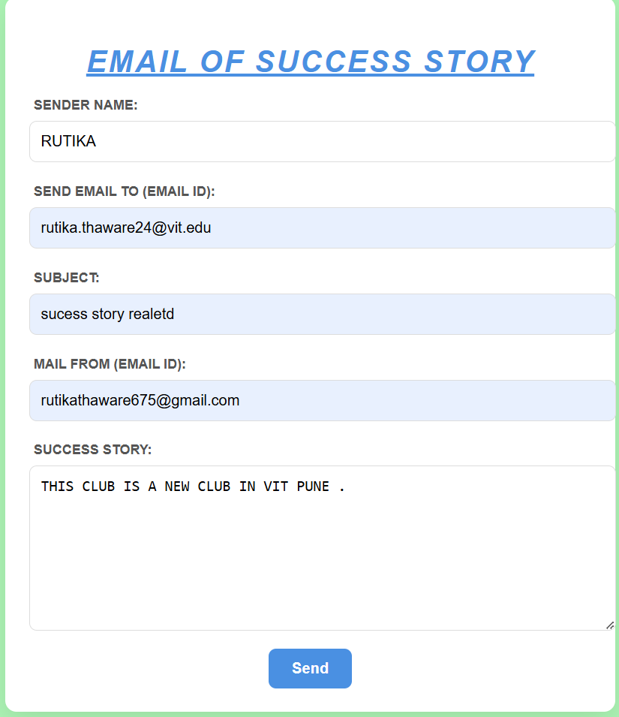
JAVASCRIPT FOR EMAIL AND STORY
USED EMAILJS FOR SENDING MAILS , INCLUDED A EMAILJS LIBRARY THROUGH CDN WHICH IS AN EXTERNAL SERVICE THAT ALLOWS TO SEND MAILS .

Slide 7
Java script used:
Ensures both fields are filled before proceeding.
.
-The script uses jQuery ($(document).ready()) to ensure that the DOM is fully loaded before executing JavaScript code.
-$('#registrationForm').submit(function(event) { ... }):
Captures the form submission event.
Calls event.preventDefault(); to stop the default form submission behavior.
-let prnPattern = /^\d{8}$/; → Ensures PRN Number is exactly 8 digits
.let phonePattern = /^\d{10}$/; → Ensures Phone Number is exactly 10 digits
.test() method is used to validate inputs against these patterns.
-$('#registrationForm')[0].reset(); resets all form fields after successful registration.
.

Slide 8
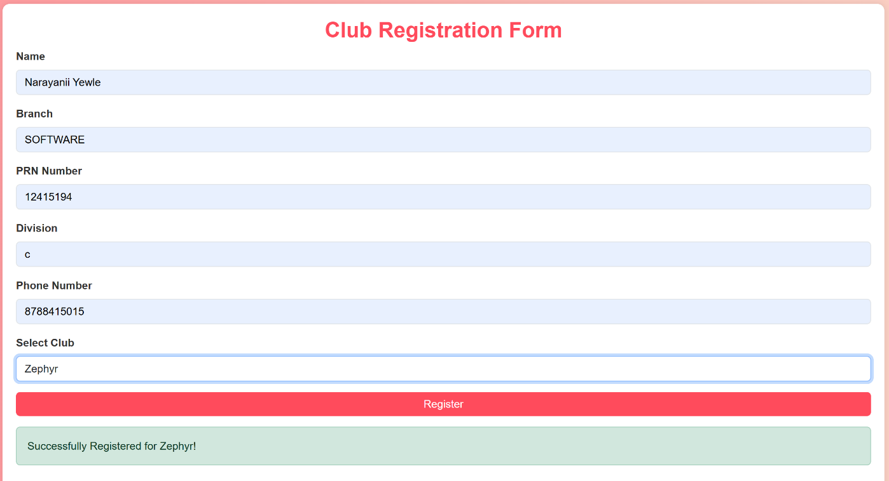
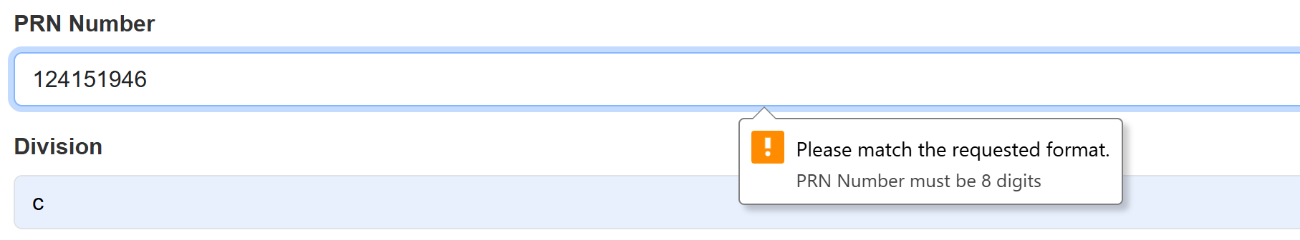
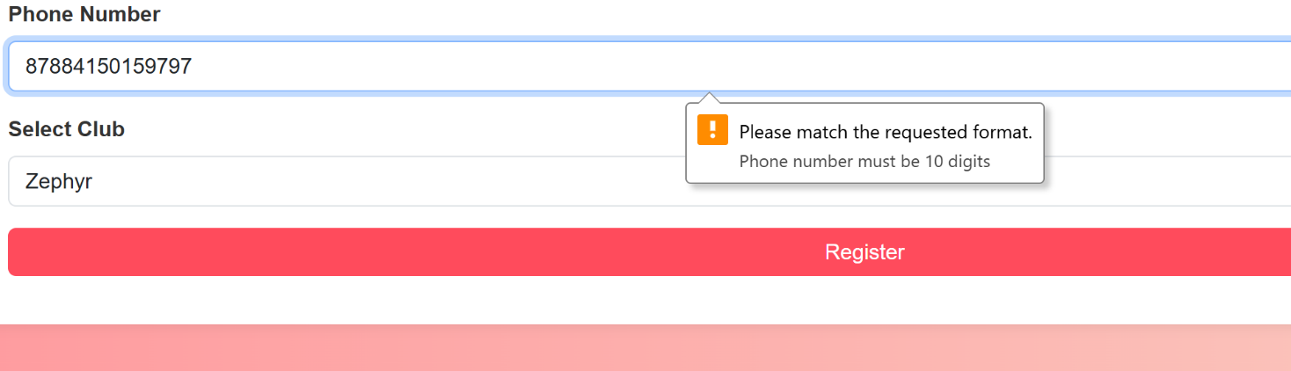
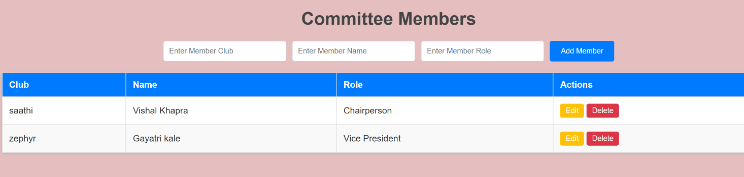
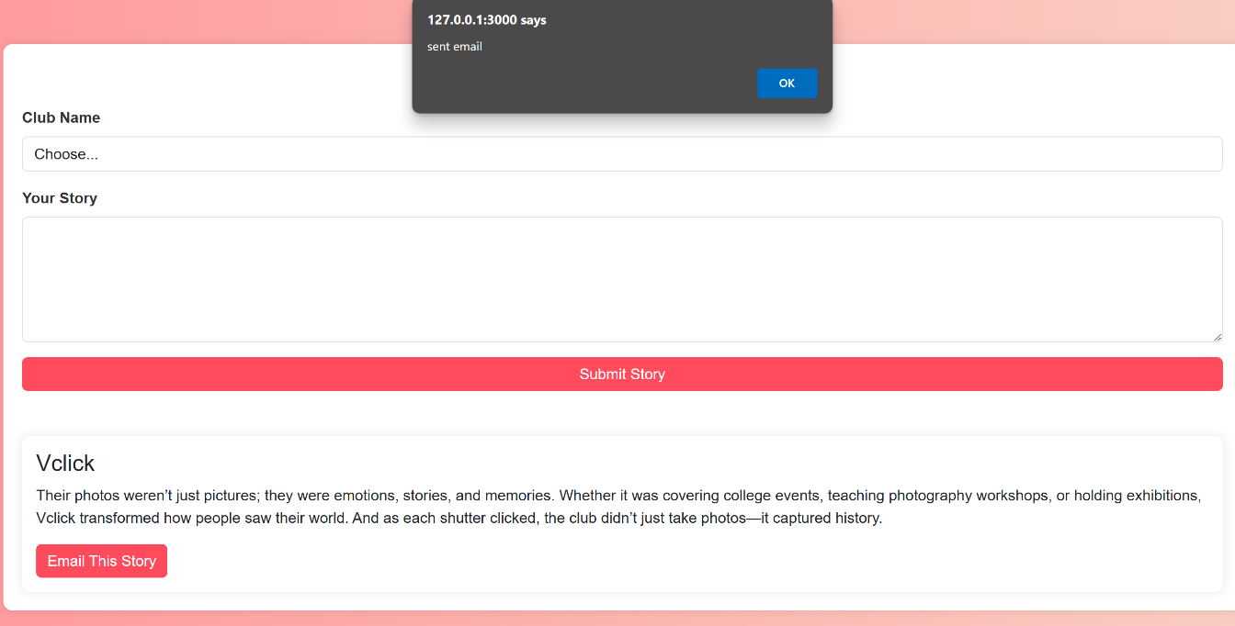

Slide 9
Javascript Features used:
Functions for reusability of code.
Document.getElementByID(): To store the data input by the user into a variable.
createElement(): Used to create a new row to display content as entered by the user.
innerHTML: Used int accordance with createElement() to modify the existing page. Here, it is used to add content including committee members or story as entered by the user to the rows created using createElement().
Preventdefault(): Used to cancel the event if it is cancellable or prevent the default action. Here, it is used to prevent reloading of the page to allow data to be stored in LocalStorage.
EmailJS is used to send new additions of stories which are entered by the user to students.

Slide 10
The JavaScript features used for making of the website are:
(Function)=>{ this is the particular syntax of a function; function are basically blocks of code that are reusable }
for Loop -> this type of loop is used for frequent iterations in a given range
If-else statements -> this is usually used to compare things and edit it in our way
Document Object Model (DOM)=>{
In this I have used document.querySelector('.class'); to choose the Tag and used the features like .innerHTML to manipulate the html content of a specific tag as per the class and .value to get the value inside a tag}

Slide 11
5. Arrays = [ I have used arrays in order to store the members name and to send them message as well as to add the success stories in the assignment also I have used various array operations like .push , .splice ,.length in order to edit the data ];
6. LocalStorage -> I have used local storage to store the credentials in the storage and make it such that it simply doesn’t vanish when page is refreshed I have also used .setItem(); to set the items and .getitem(); to get the item when required
7. JSON -> I have used JSON operations like .stringify and .parse to convert other things like arrays into strings and to parse the string and again convert it into its original form
8. Objects -> I have used objects to store the name of various students at vit (my main agenda was to replicate something like a database)
9. Event -> I have also used event.key by which when an event form the keyboard is found out it does the task but in short cut merged with onkeyup=" " feature of the tags

Slide 12
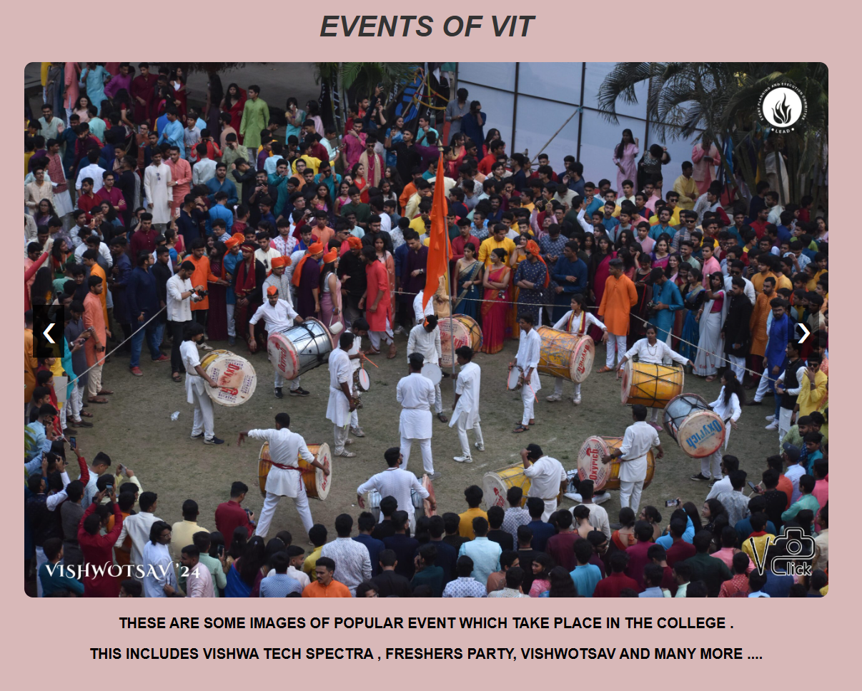
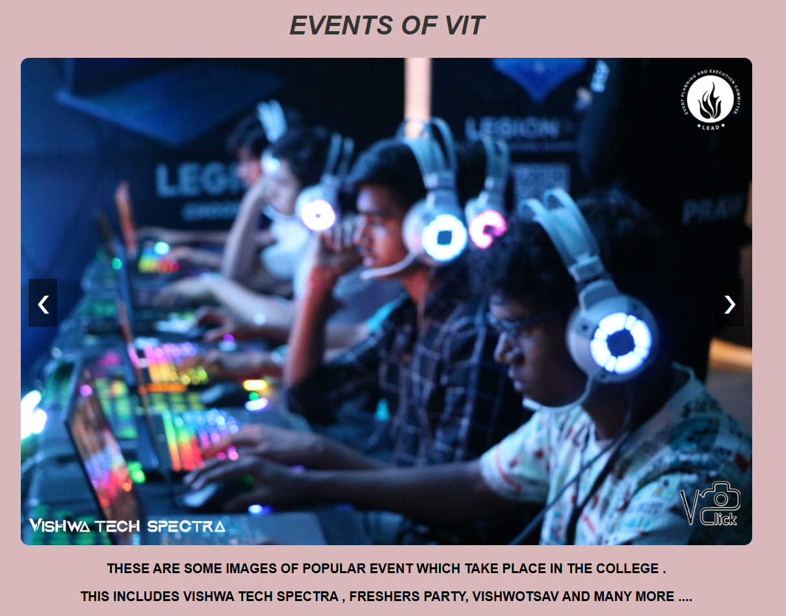
JQUERY
USED JQUERY IN IMAGE SLIDERS .
IT IS A JAVASCRIPT LIBRARY .
FIRST , IN SCRIPT TAG JQUERY LIBRARY IS MENTIONED .
THE BASIC SYNTAX IS $(SELECTOR).ACTION
WHEN THE .NEXT BUTTON IS CLICKED THERE IS INCREMENT
IN SLIDE AND SHOWSLIDE() FUNCTION IS CALLED TO
DISPLAY NEXT SLIDE .
WHEN .PREV BUTTON IS CALLED , THERE IS DECREMENT
AND SHOWSLIDE() IS CALLED TO DISPLAY PREVIOUS SLIDE .

Slide 13
JQuery used:
$(document).ready(...) - Ensures the DOM is fully loaded before running scripts.
$('#storyForm').submit(...) - Listens for form submission and prevents page reload.
DOM Manipulation ($('#stories').append(...)) - Adds new stories dynamically.
Event Delegation ($(document).on('click', ...)) - Handles dynamically created buttons.
$(this).data(...) - Retrieves custom data attributes (data-club, data-story).
Updates the content of #responseMessage with success or error messages dynamically.

Slide 14
JQuery Features Used:
$(document).ready(function()): Ensures Document Object Model is loaded before execution of the Javascript or JQuery file.
.on(): Used for adding events to the file. Here, it is used to store the data in Localstorage on pressing the submit button.
.val(): Used to store the value that is entered by the user in the field of a particular ID in a variable.

Slide 15
The JQuery features used for making of the website are:
$(document).ready()=> This ensures that script runs after DOM is fully loaded.
.each()=>{Loops through multiple elements.}
.delay()=>Delays animation execution.
.hover()=>Adds effects when mouse enters/leaves.
.click()=>Binds a click event to elements.
.slideToggle()=>show and hide elements with a sliding animation

Slide 16
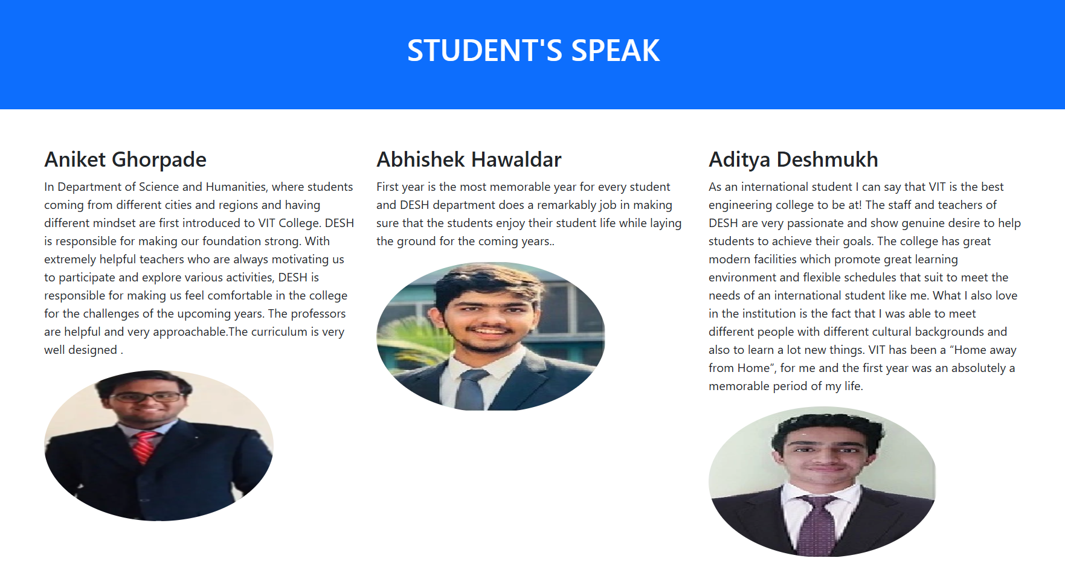
BOOTSTRAP
BOOTSTRAP IS A FRONTEND FRAMEWORK THAT IS USED TO MAKE RESOPNSIVE
DESIGNS .
SCRIPT TAG IS USED TO MENTION A LINK TO AN EXTERNAL BOOTSTRAP STYLESHEET FROM A CDN.
EXAMPLE : <div class="container-fluid p-5 bg-primary text-white text-center">
<div class="container mt-5">

Slide 17
Bootstrap used:
Bootstrap for Styling & Form Validation
The script relies on Bootstrap's classes for styling and layout.
The <select> element requires a valid selection before submission.
Loads Bootstrap 5.3 CSS for styling and JavaScript for interactive components.
-The .container class is used to create a responsive, centered layout.
-form-label improves label styling
.mb-3 adds margin-bottom for spacing.
.form-control provides Bootstrap-styled input fields.
mt-5: Adds top margin for spacing.
form-control: Styles form inputs with Bootstrap’s standard padding, border, and focus effects.
btn btn-primary: Styles the button with Bootstrap’s primary color.w-100: Makes the button full-width.

Slide 18
Bootstrap features used:
Fixed-top: Used to position the navbar at the top of the page and keeping its position fixed on scrolling.
Dropdown dropdown-toggle: Used to create a toggleable menu that allows the user to select an option. Here, it is used to redirect the user to a specific club from the navbar.
Img-fluid: Used to automatically adjust the size of the image to fit the size of parent. Thereby making the image responsive.
Btn btn-danger: Used to style buttons on the HTML page. Btn-danger is used to give a red color to the buttons.

Slide 19
The Bootstrap features used for making of the website are:
.btn: Applies Bootstrap's default button styles.
.container: Centers the content and provides automatic padding.
.form-label → Styles labels properly.
Fw-bold -> Bold font weight

Slide 20
krish

